Slide 1
WhatsApp or Facebook Messenger
Submitted by: Abeda “Saeedi”

Slide 2


WhatsApp:
Has green color
Facebook Messenger:
Has mix color

Slide 3


Facebook Messenger:
WhatsApp:
Independent .
Dependent on the Facebook.

Slide 4
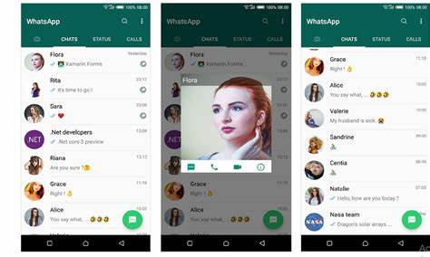
Show the last time of online

Slide 5
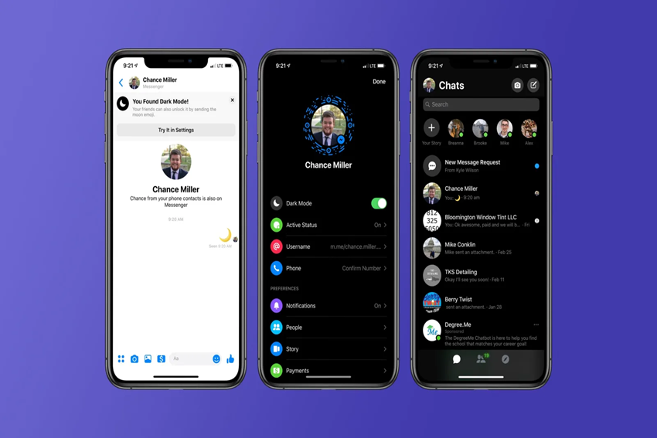

Slide 6
Thank you

